Slide 1

Lab Management System
A Comprehensive Solution for Efficient Computer Lab Sessions

Slide 2

Project Details
Group -7
Members
Arun George
Deepu Kochumon
Jibil Joseph
Jissin Sam Mathew

Slide 3

Introduction
The Lab Management System proposed in this project is a comprehensive solution designed to enhance the efficiency and effectiveness of computer lab sessions...
We present a Lab Management System designed to enhance computer lab efficiency for both students and faculty.
It assists students in various ways but also contributes to enhancing their overall capabilities and academic performance.

Slide 4
Literature Survey
"A Review of Lab Management System Techniques" by Ananya Patel, Rajesh Kumar, and Neha Sharma. This review article summarizes the techniques used for lab management system, including scheduling optimization, attendance tracking, and student feedback analysis. It also discusses the challenges of lab management system implementation and future research directions.
"Student Feedback Management: A Review and Framework for Analysis in Lab Management Systems" by Meena Suresh, Sneha Patel, and Karthik Reddy. This article reviews the literature on student feedback management in lab management systems and proposes a framework for analyzing student feedback data. The framework includes three stages: feedback collection, analysis, and implementation.

Slide 5

Challenges Faced Today
Students face delays in accessing their lab section attendances promptly.
Immediate visibility of viva marks is unavailable for students.
Lack of clear guidance on where and what to learn.
Ineffective Communication Channels.
Scheduling Conflicts.

Slide 6





Abstract
Attendance Tracking for Real-time Insights
Coding Program Enhancement
Continuous Improvement through Student Feedback
Dashboard for Streamlined Administration
Enhanced Communication Channel

Slide 7
Features
Userfriendly Interface
Attendance Tracking
Marking System
Student Review system
Student Doubt clearance
Lab schedules and Portions
Activity Tracking
Feedback System

Slide 8



Tools Used
FRONT END
BACK END

Slide 9
Expecting Output
This website aims students and faculities,students can view their attendance,viva marks,lab details schedules,portions.
It helps them to improve their lab performance and reduce their stress.
Faculities can easily manage the students,their interaction,communication become more effective through a good communication channel,sent targeted messages regarding lab sessions,assignment updates or any other relevant information.
It helps them to know and guide students more efficiently.
The Webapplication Shows Students List,Viva Marks,Attendance,lab Allotment and Schedules,Faculity Details,Reviews,lab Syllabus, instructions from faculities and many more like this.

Slide 10
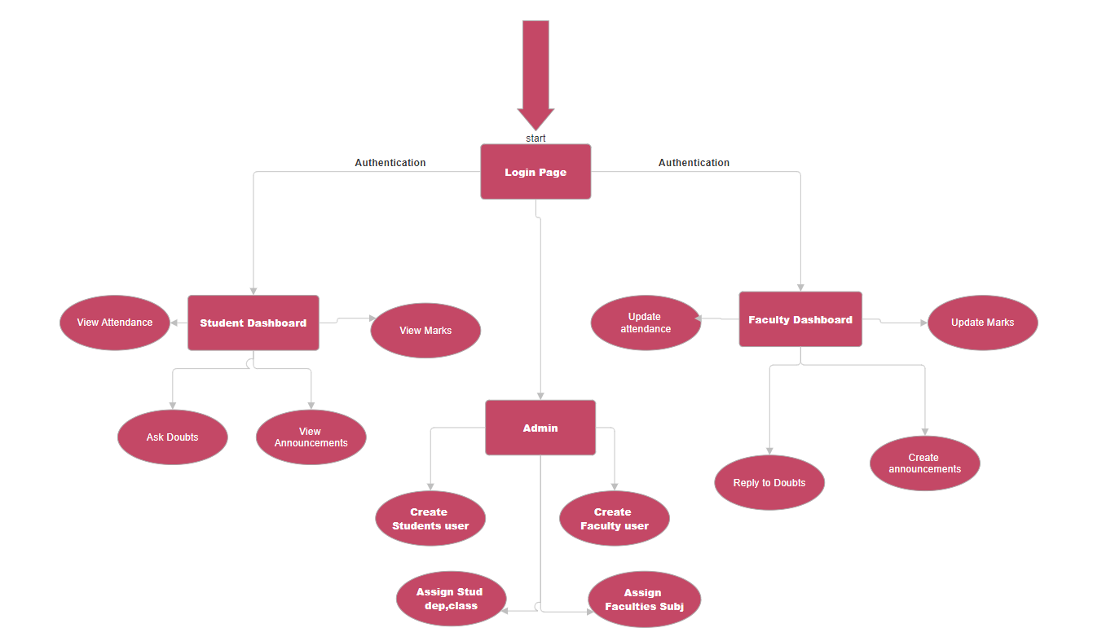
Block Diagram

Slide 11
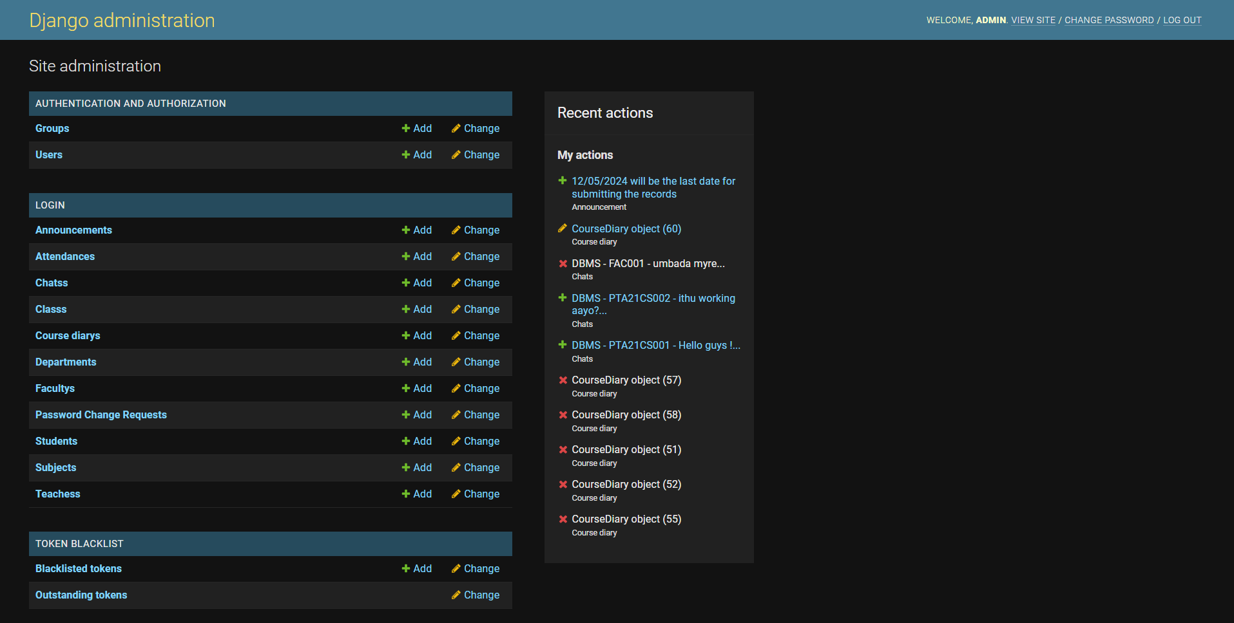
Database

Slide 12
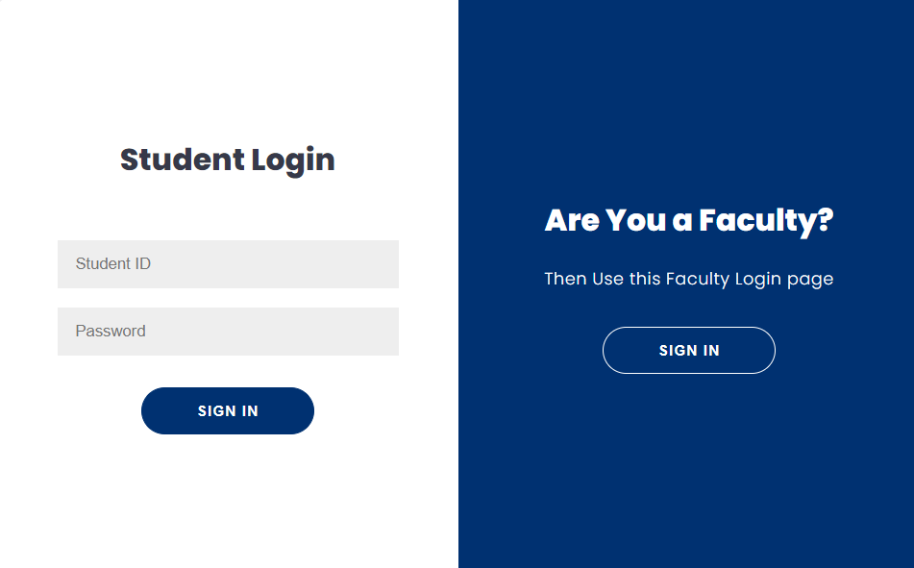
Login Page-Student Login

Slide 13
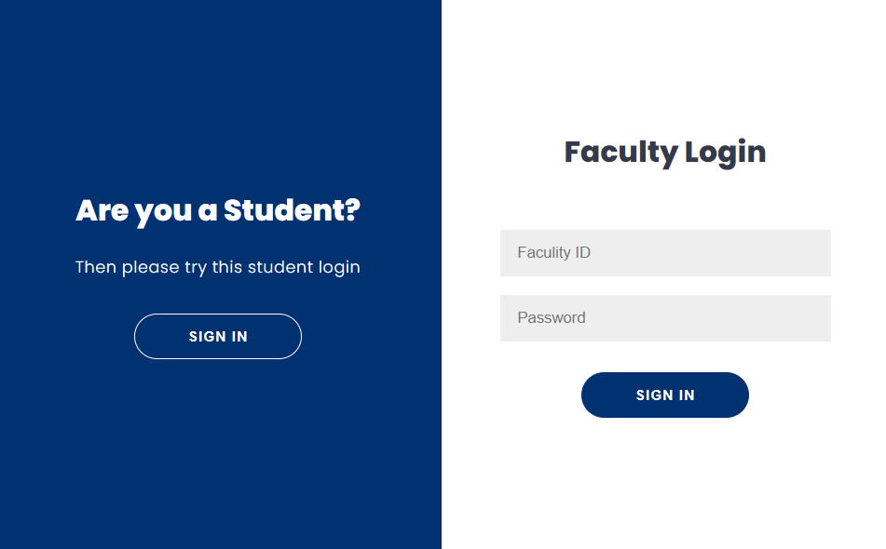
Login Page-Faculity Login

Slide 14
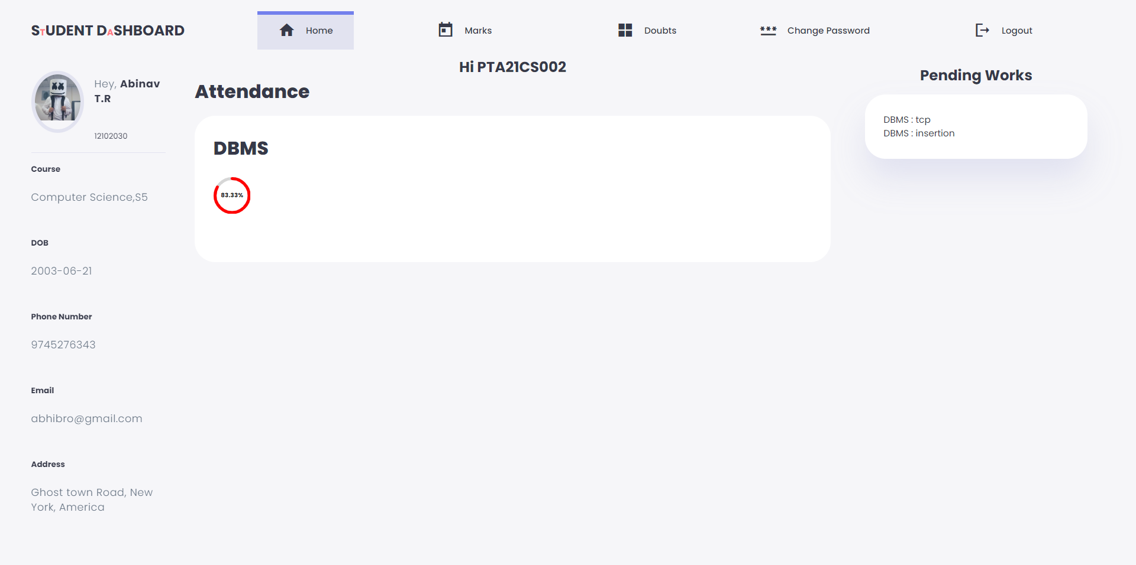
Student DashBoard-Home

Slide 15
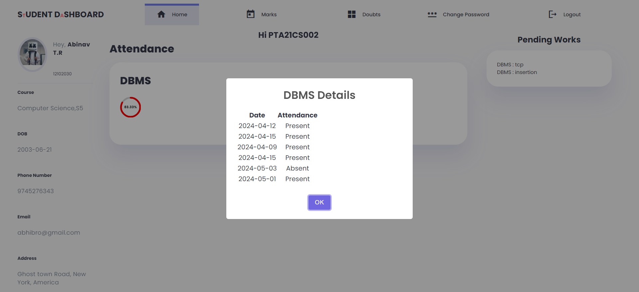
Student DashBoard-Home

Slide 16
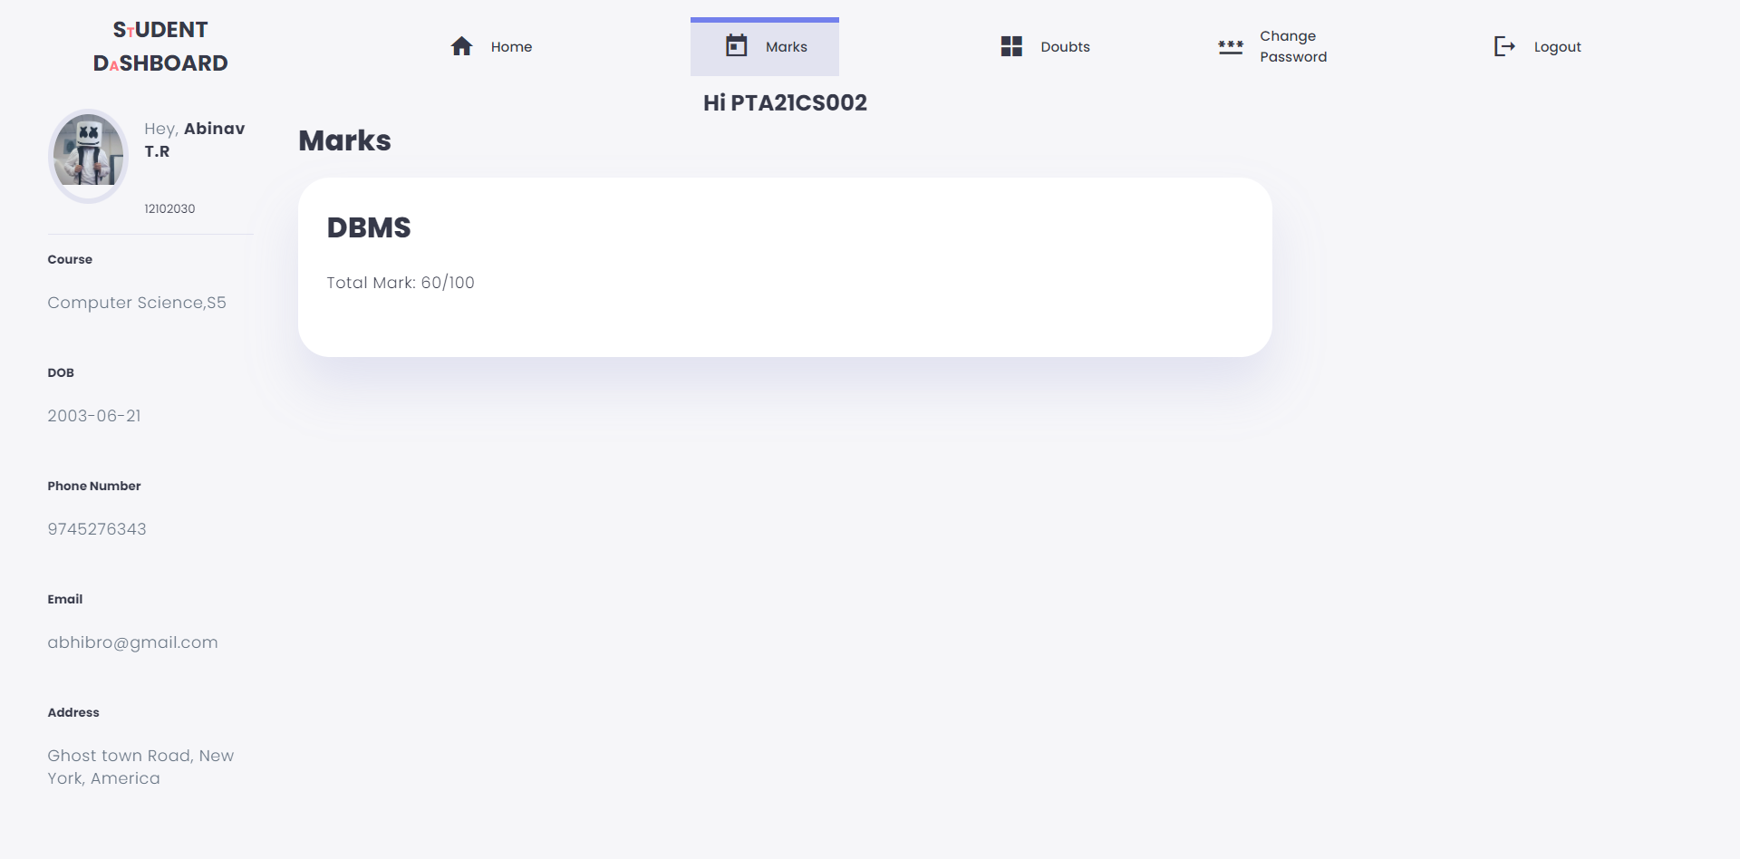
Student Dashboard -Marks

Slide 17
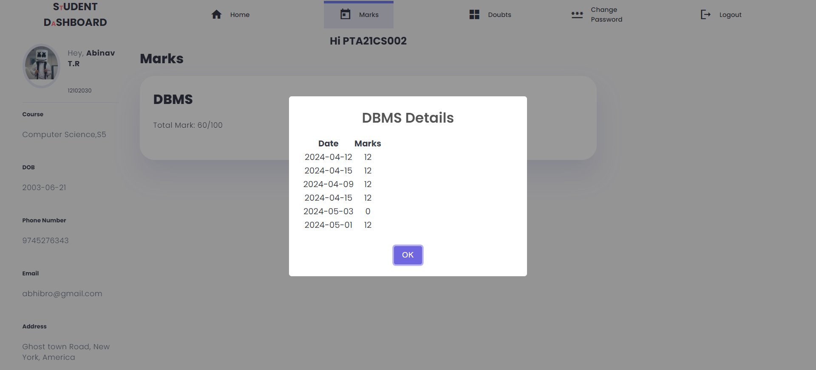
Student Dashboard -Marks

Slide 18
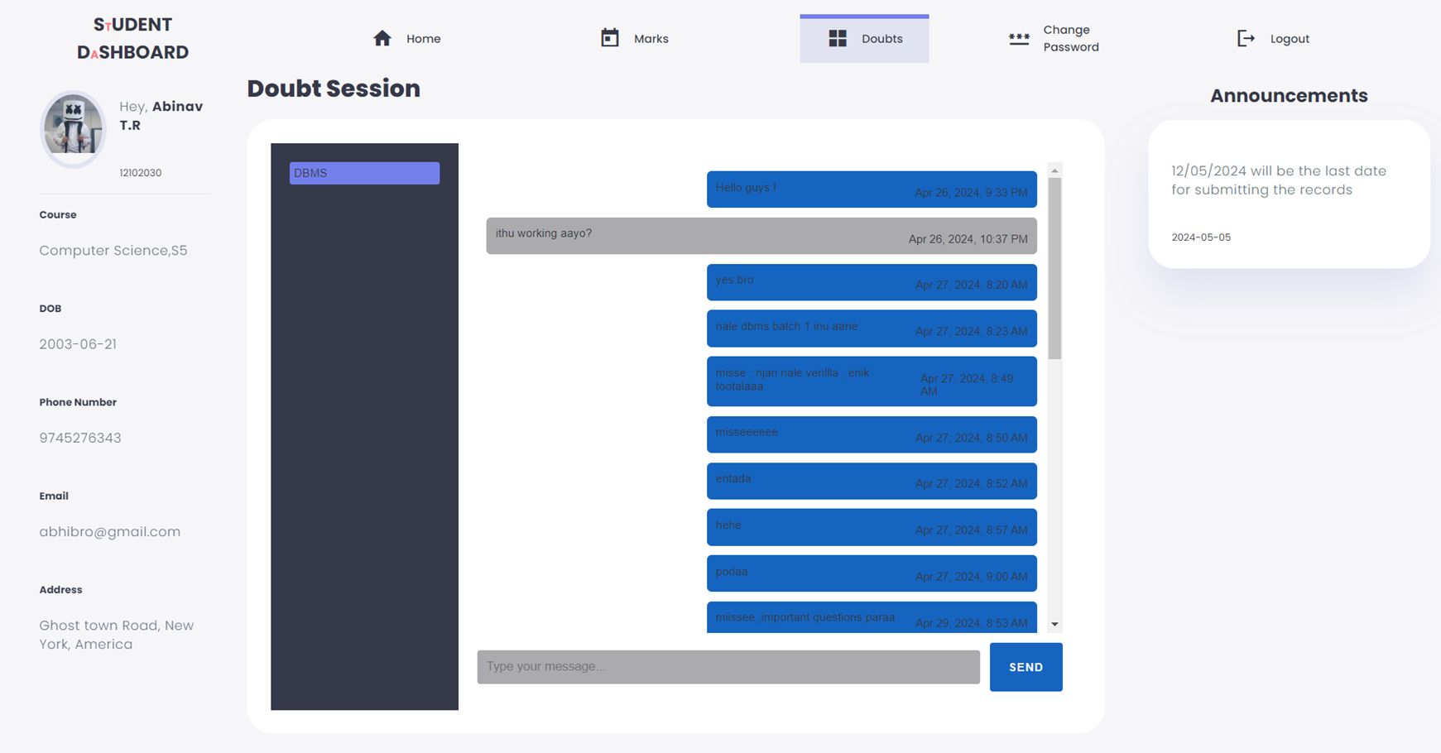
Student Dashboard -Doubts

Slide 19
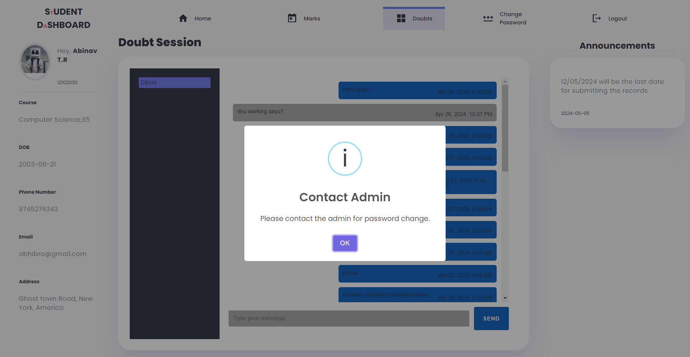
Student DashBoard-Change Password

Slide 20
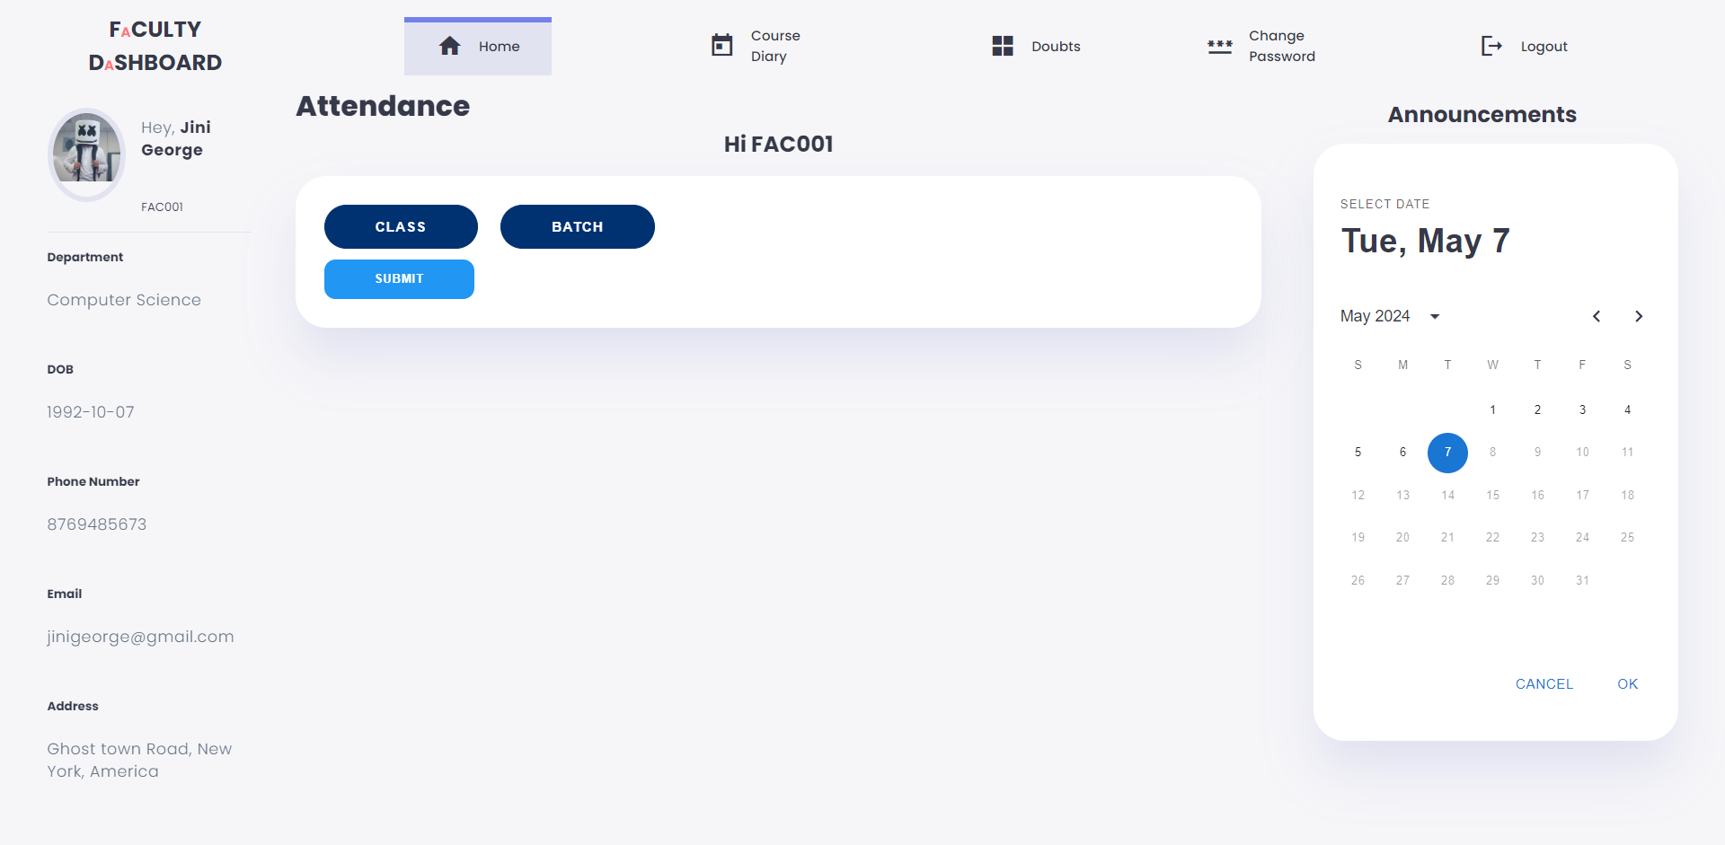
Faculity DashBoard-Home

Slide 21
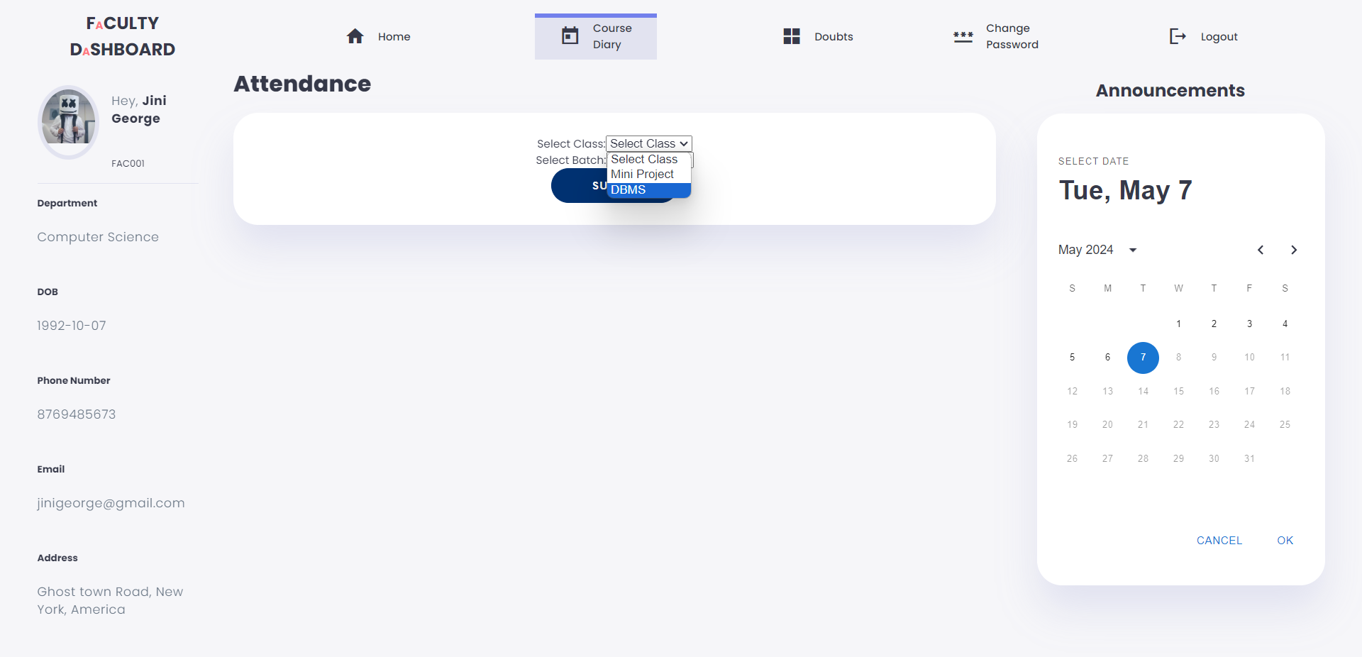
Faculity DashBoard-Course Diary

Slide 22
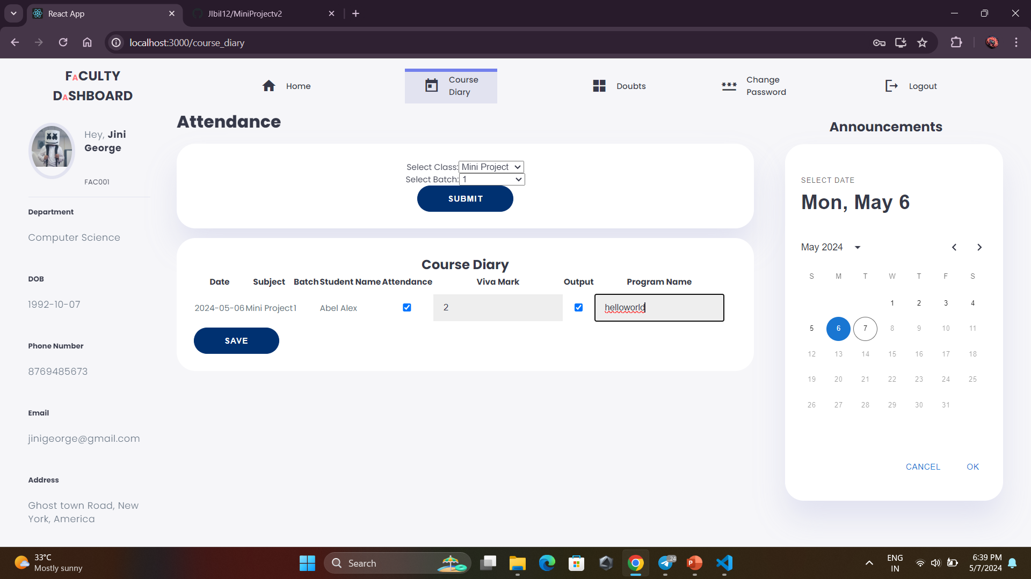
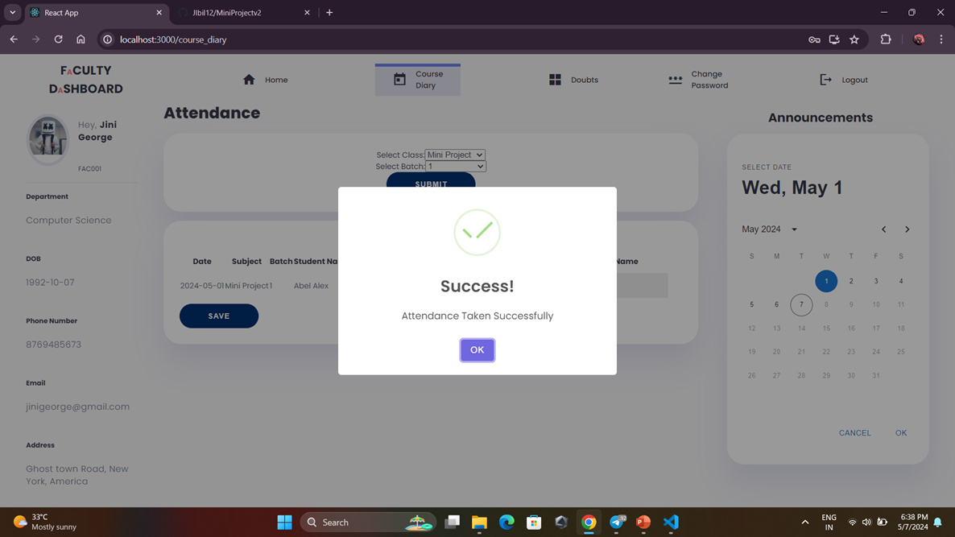
Faculity DashBoard-Attendance Taking

Slide 23
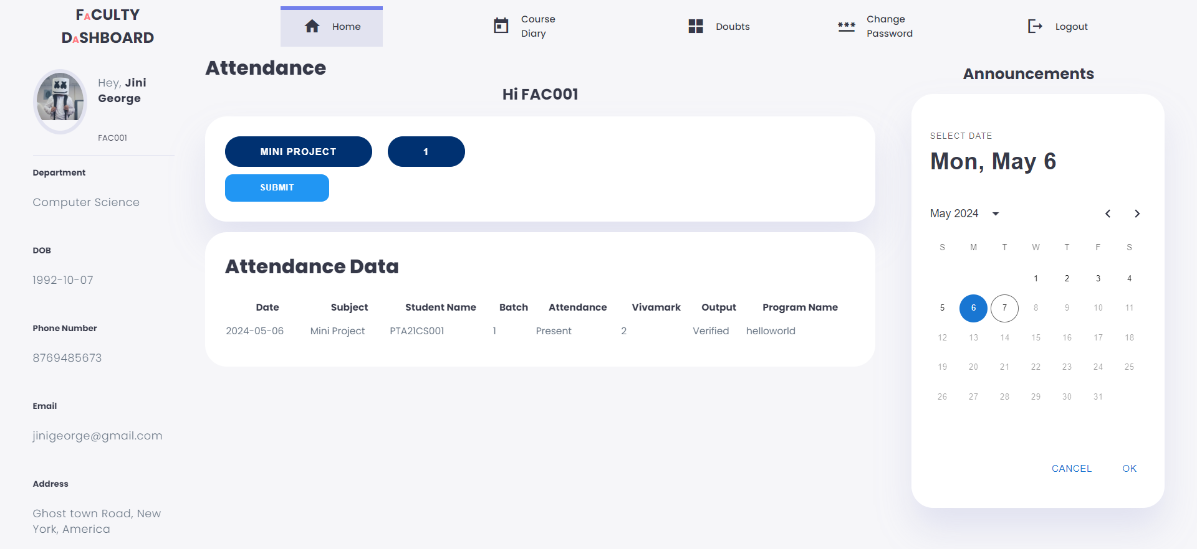
Faculity DashBoard- Home After Attendance Taking

Slide 24
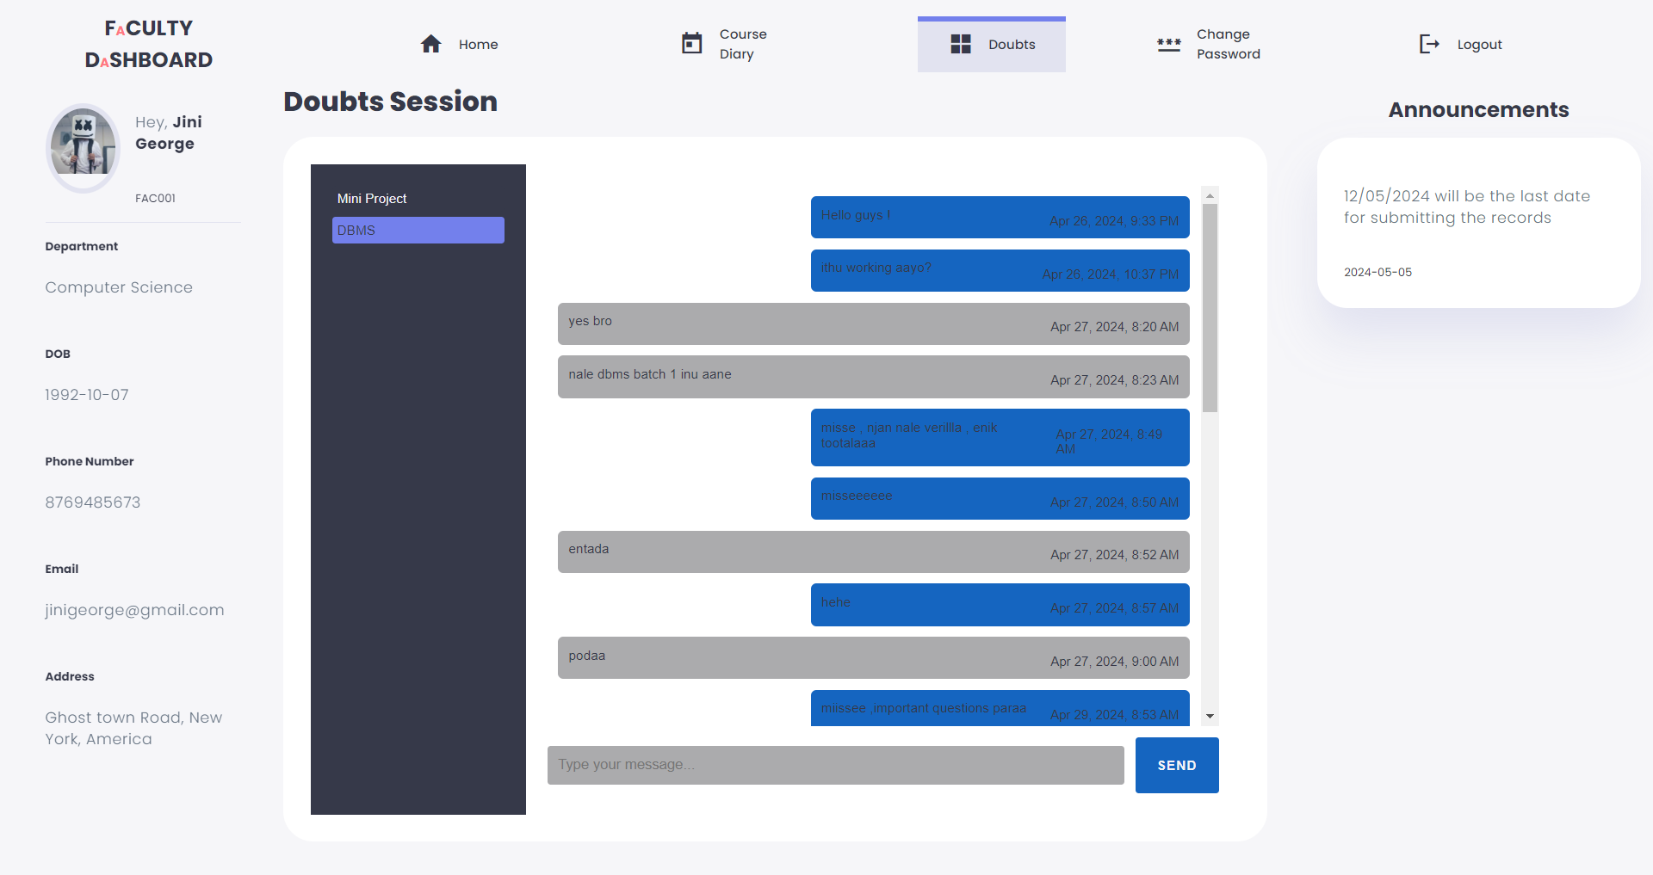
Faculity DashBoard-Doubts

Slide 25
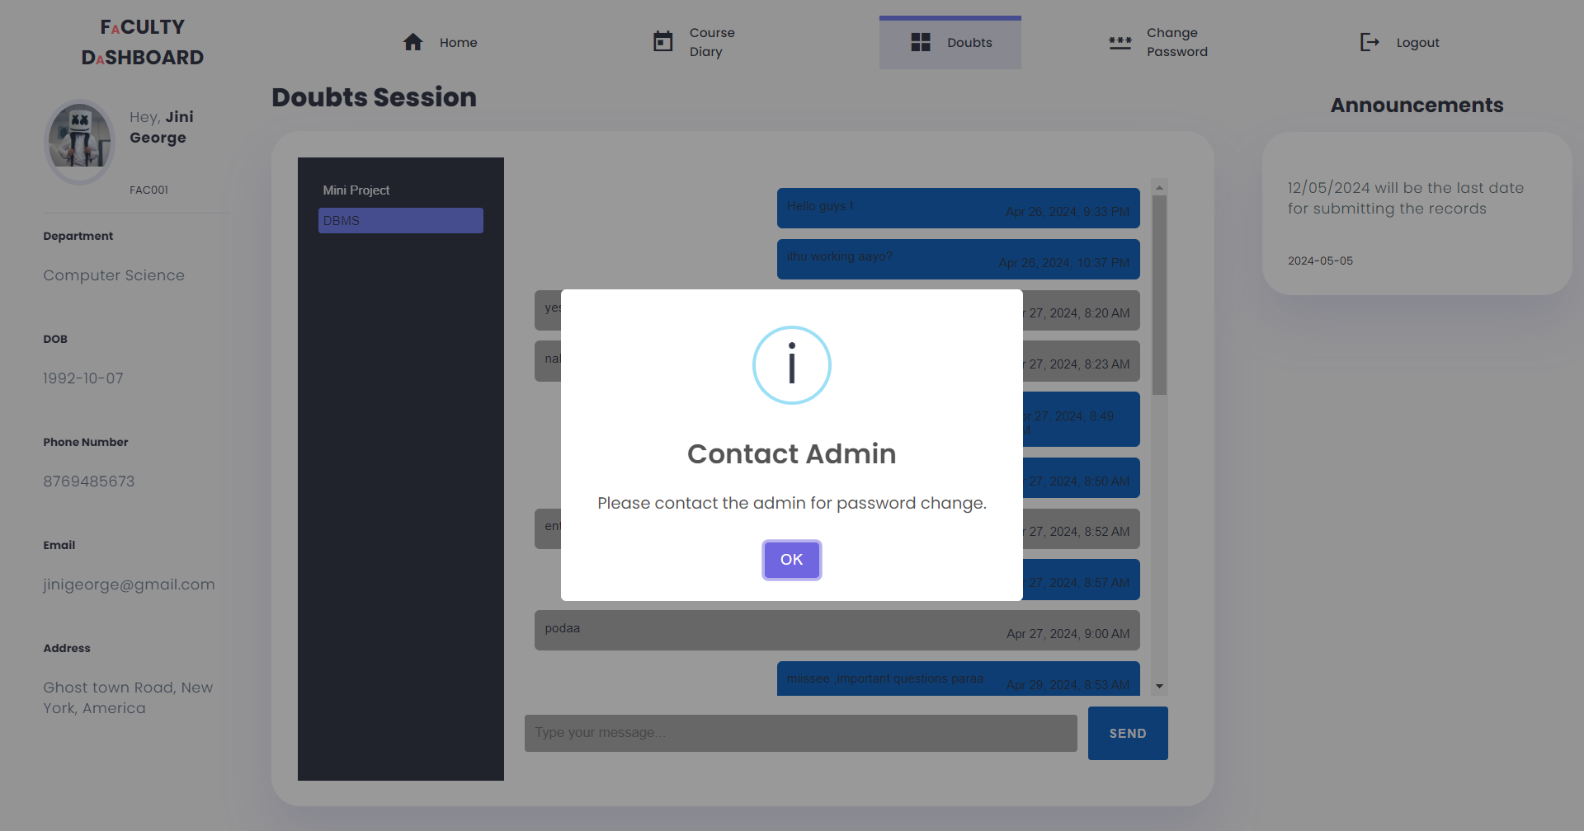
Faculity DashBoard-Change Password

Slide 26
Conclusion
The Computer Lab Management System presented in this project seeks to create a harmonious and efficient learning environment for both students and faculty. By addressing key aspects such as schedules, attendance, coding errors, student feedback, and faculty communication, the system aims to foster a collaborative and effective computer lab experience.

Slide 27

References
Patel, R., Desai, K., Shah, M., & Patel, N. (2023). "Design and Implementation of Lab Management System." International Journal of Engineering Research and Applications, 10(5), 120-125.
Sharma, S., Singh, A., Gupta, R., & Kumar, V. (2022). "Enhancing Educational Efficiency: A Study on Lab Management Systems." Journal of Computer Science and Information Technology, 8(3), 45-51.
Brototype Youtube Channel

Slide 28

Thank You

